Slide 1
Fair Skin Lesion Classification
By: Kedarnath P
M.tech CSA
SR NO: 20902

Slide 2
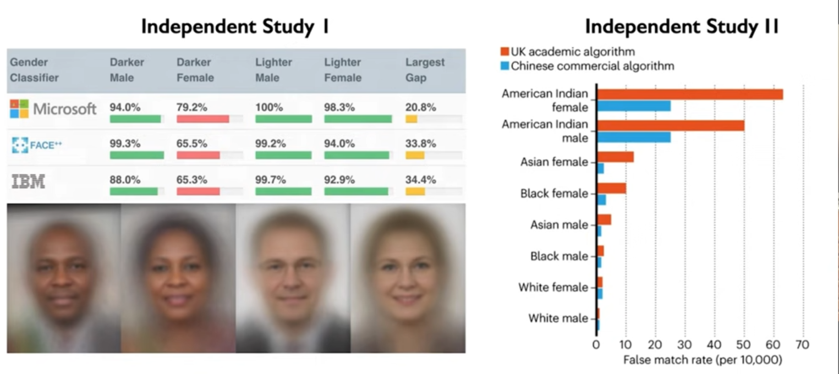
INTRODUCTION: Bias and Fairness in AI
What exactly is Bias in a model?
Example: Racial Bias in Face Detection
Credits: MIT Introduction to Deep Learning 6.S191: Ava Soleimany

Slide 3
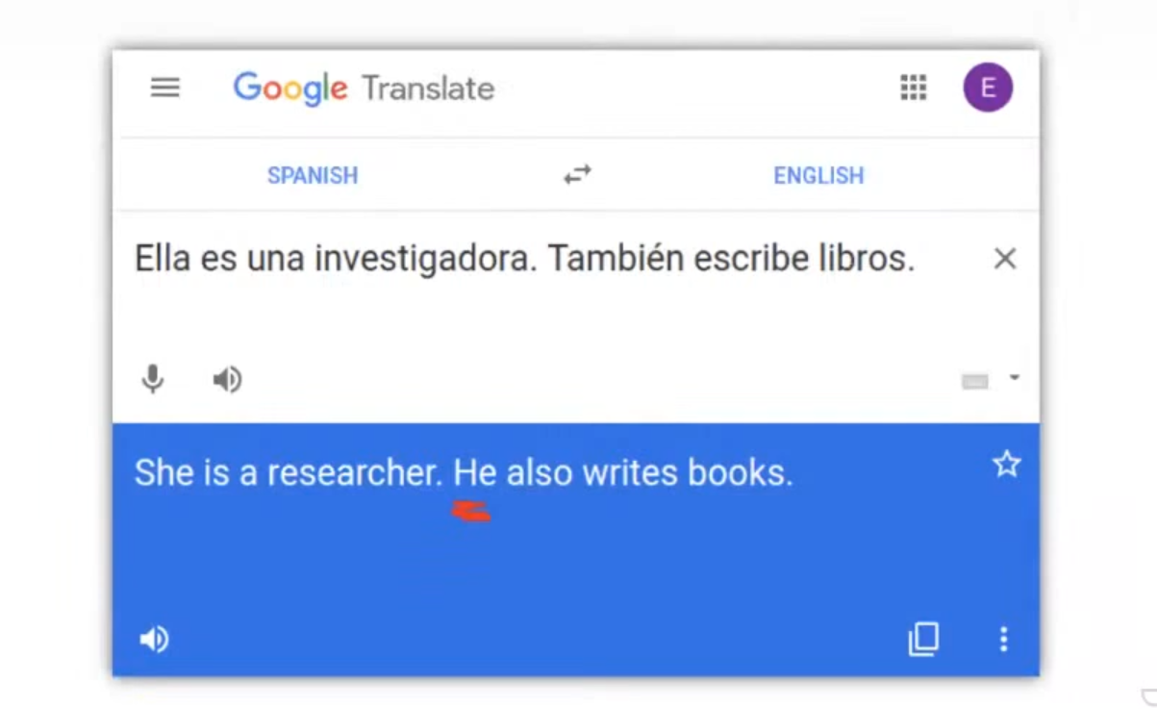
Another example: Gender Bias in NLP
Credits: Fairness of machine learning classifiers in medical image analysis: Enzo Ferrante, Research Scientist, Argentina's National Research Council (CONICET)

Slide 4
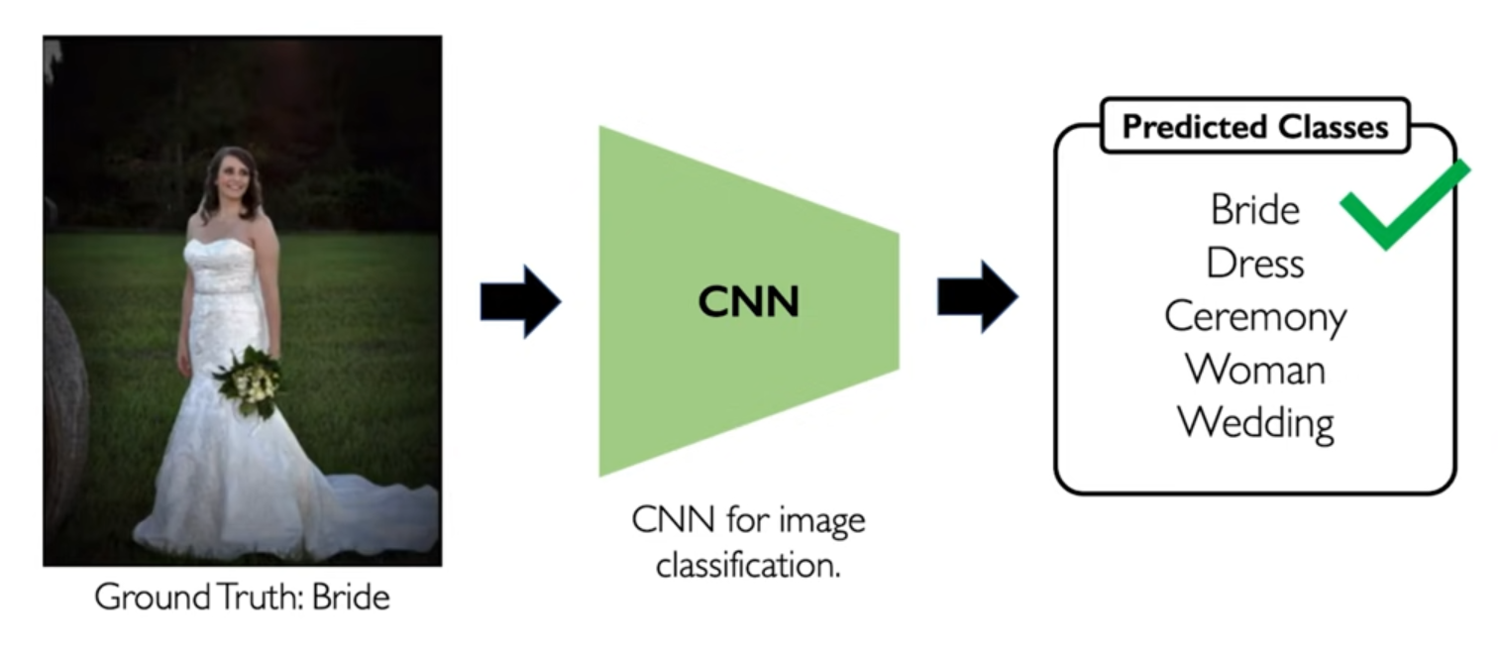
Another example: Bias in Image Classification (due to feature imbalance)
Credits: MIT Introduction to Deep Learning 6.S191: Ava Soleimany

Slide 5
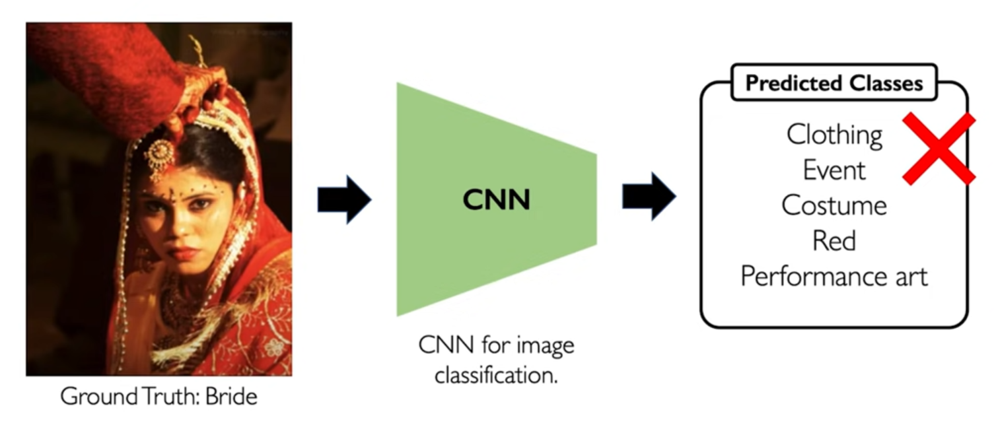
Another example: Bias in Image Classification (due to feature imbalance)
Credits: MIT Introduction to Deep Learning 6.S191: Ava Soleimany

Slide 6
MOTIVATION BEHIND PROJECT SELECTION
By the previous examples, we can say that the bias in AI models is a serious concern
and they need to be addressed.
Especially in medical domain, as it may cost the life of a patient as a result of
incorrect diagnosis due to biased models.
Hence there is a need for “Fairness” of classification models which justifies the
title of our project “Fair Skin Lesion Classification”.
Here we define Fairness as both algorithmic fairness (in context of demographic data)
as well as in the context of imbalances (class, features).

Slide 7
PROJECT PROPOSAL IN TWO PHASES:
Phase I: Investigating Bias in classification models for this particular task.
Phase II: Employing various Bias Mitigation techniques and evaluating their
effect on model performance by ensuring fairness using
demographic parity check.
(i-e, performance of models among different sub-groups).

Slide 8
DATASET:
Lesions are abnormal changes in the structure or function of tissues or organs in the body through
injury, infection, inflammation, tumour, etc.
The ISIC (International Skin Imaging Collaboration,) 2018 challenge used the HAM10000 dataset
which was released by researchers associated with the Department of Dermatology
at the Medical University of Vienna, Austria.
The goal of the competition was to determine whether machine learning algorithms could achieve
similar or better performance than human experts in this task.
It was aimed to promote the development of automated systems for skin lesion diagnosis and classification.
Specifications of Dataset:
Size : ~2.57 GB
Images: 10,015
Meta-data is provided ( including demographic data like age, gender, etc)

Slide 9
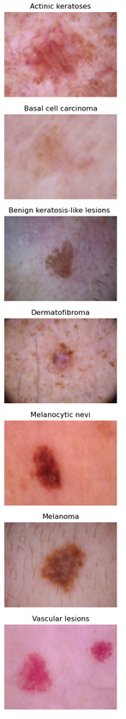
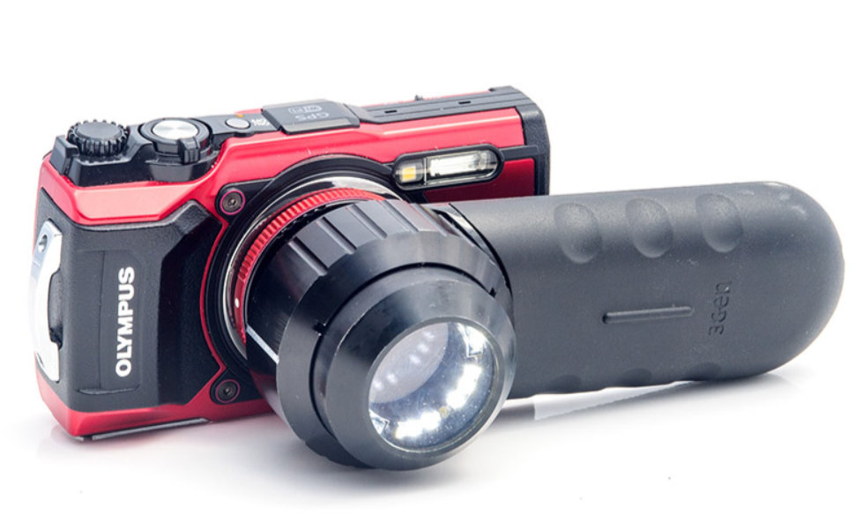
Sample Images from Dataset:
Task: Multi-class (7) classification problem.
Given an Image of Skin lesion, We need to predict the skin lesion type (class) for the diagnosis.
These are dermatoscopic images taken by a dermatoscope.

Slide 10
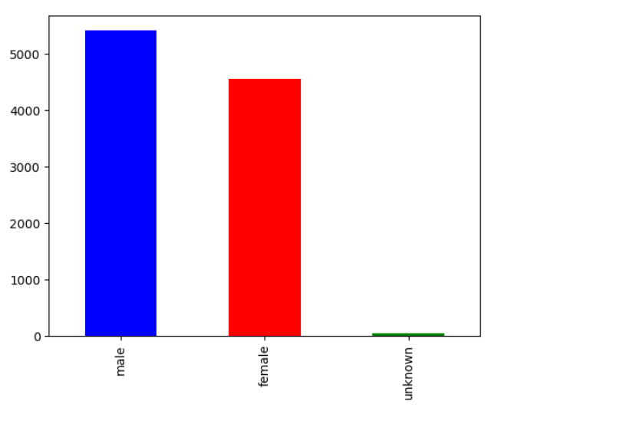
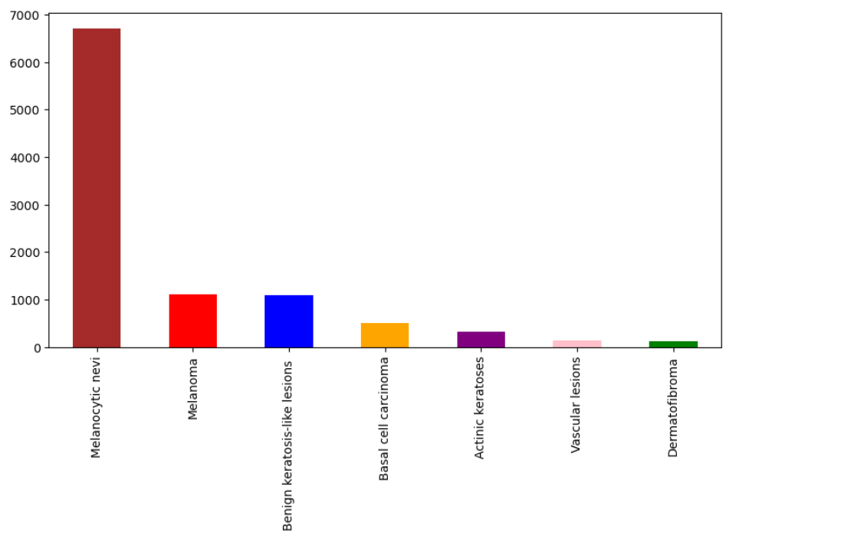
Key Sources of Bias in Model predictions:
Data: Class Imbalance, feature imbalance, demographic Imbalance, etc. Evaluation: If No Fairness metrics like demographic parity check is used, then we might develop biased models.
Sources of Bias in our task:
Class Imbalance
Gender (Demographic) partial Imbalance

Slide 11
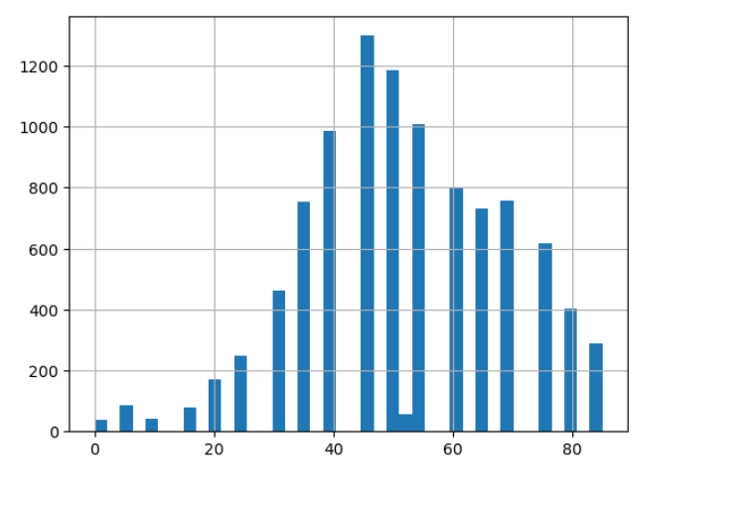
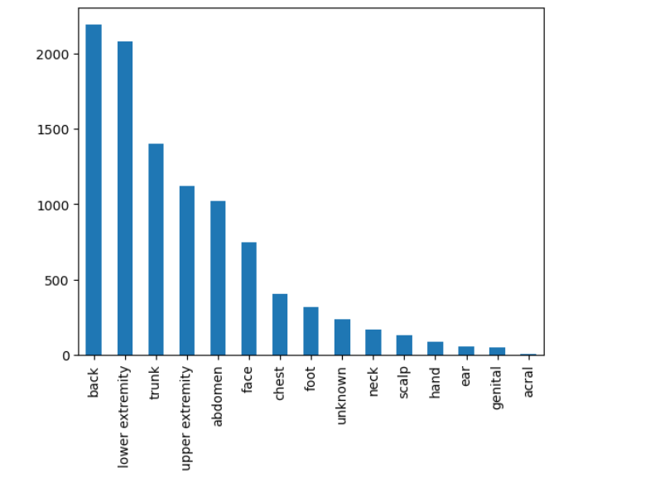
Sources of Bias in our task:
Age (Demographic) Imbalance
Localization (Feature) Imbalance

Slide 12
Phase I : Bias Investigation
(for Mid-Term)

Slide 13
Experiment setting:
Use popular CNN models which are pre-trained on ImageNet dataset and then
fine-tune for the skin lesion classification task.
We propose to use popular CNN model Densenet121 for our Experiment as many research papers were using densenet for skin lesion classification task.
For the densenet model:
We Train the model on Train data and then Test them on the Test dataset(balanced) by performing demographic disparity check. We test on:
1. Overall Test data. 2. Gender(Male and Female test) data separately.
3. Four Age groups below 20 years, 20-40 years, 40-60, above 60 years
test data.
4. Localization (upper, mid, lower) body regions.
5. These can be typically considered as hidden features causing bias in the model.

Slide 14
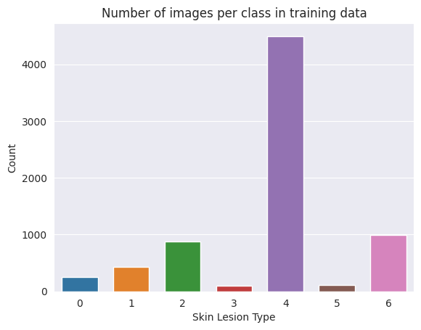
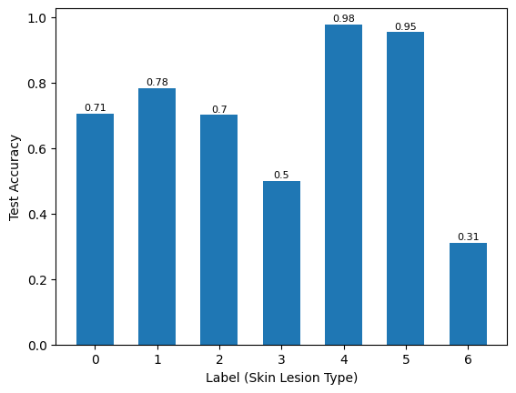
Observations: performance of Densenet121
(1) Class Bias
{0 : Actinic keratoses , 1 : Basal cell carcinoma, 2 : Benign keratosis-like lesions, 3 : Dermatofibroma,
4 : Melanocytic nevi , 5 : Vascular lesions, 6 : Melanoma}
Model is Biased towards specific classes (especially class label 4 as it’s the majority class in training data).

Slide 15
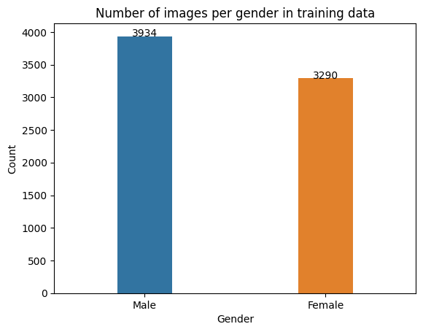
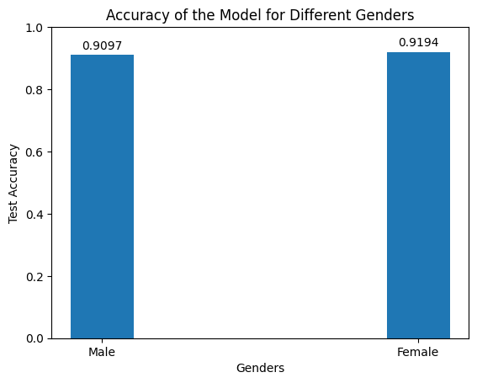
Observations: performance of Densenet121
(2) Gender (hidden feature) Bias
There is No Bias in model’s performance towards specific gender (given partial imbalance in train dataset) .
Even after creating an Imbalance between Male and Gender, there was no huge difference in accuracies on male and female test set.
Difficulty in learning Male features (body hair, beard, etc) than female features despite more samples of males.

Slide 16
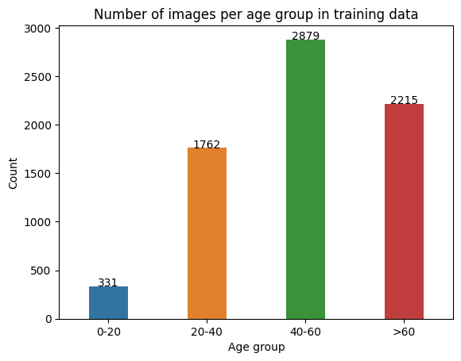
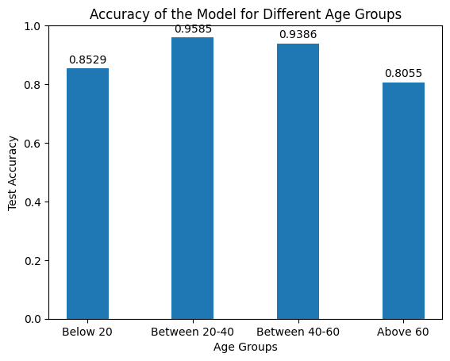
Observations: performance of Densenet121
(3) Age (hidden feature) Bias
There is Bias towards younger and mid age group .
The model is underperforming for the old-age group(above 60 years) . This may be due to the fact that old age people have complex skin structure like (aging skin).
No relationship between number of samples per age group and test accuracy.

Slide 17
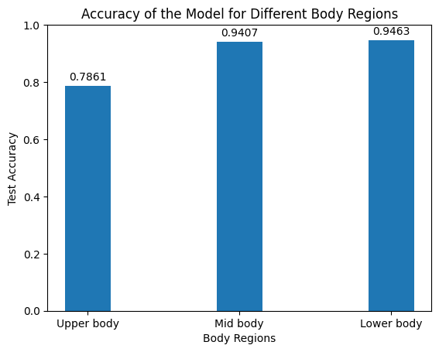
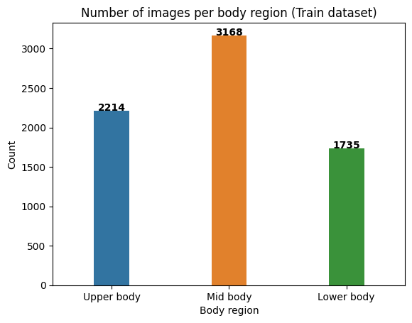
Observations: performance of Densenet121
(4) Localization (hidden feature) Bias
There is Bias towards specific localization (especially mid body and lower body regions).
The model is underperforming for Upper body regions ( may be due to complex features like hair on scalp, neck, facial hair, etc)
No relationship between number of samples per body region and test accuracy.

Slide 18
Phase I : Bias Mitigation
(for Final)

Slide 19
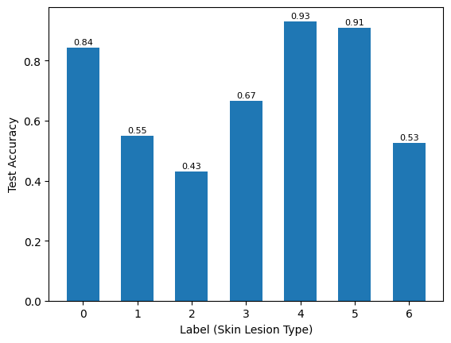
(1) Class Bias Mitigation
(by Pre-processing technique: Oversampling)
Before Oversampling
After Oversampling minority classes
Test accuracies of few minority classes have improved but still there is Bias towards majority classes.

Slide 20
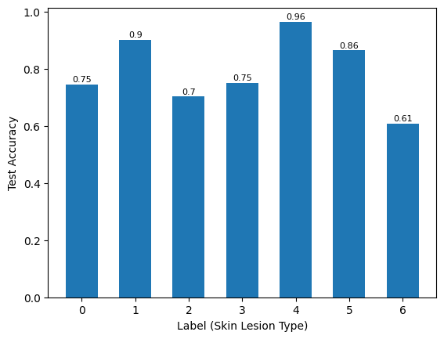
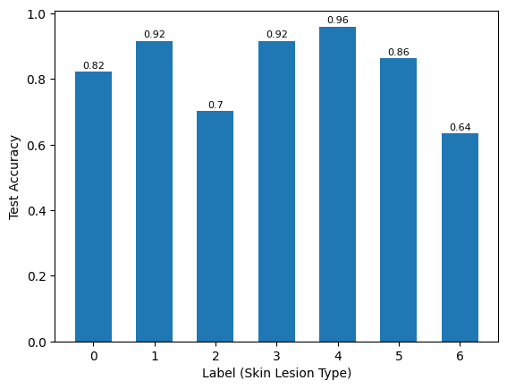
(1) Class Bias Mitigation
(by In-processing technique: Class balance loss)
Cross entropy loss
Class balance loss
Oversampling + Class balance loss
Test accuracies of few minority classes have increased.
Reduced Class bias to some extent.
Reference : Class-Balanced Loss Based on Effective Number of Samples

Slide 21
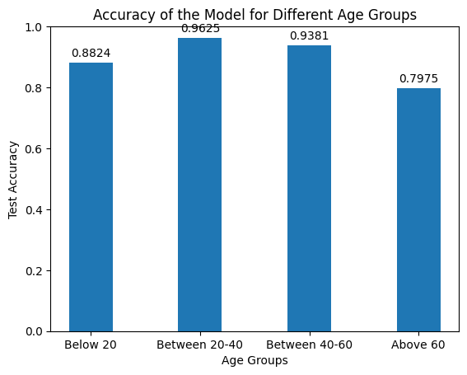
(2) Age Bias Mitigation
(by Pre-processing technique: Oversampling)
Before Oversampling
After Oversampling minority age groups
Oversampling has increased Test accuracy for younger age groups.
No significant improvement for older age groups.

Slide 22
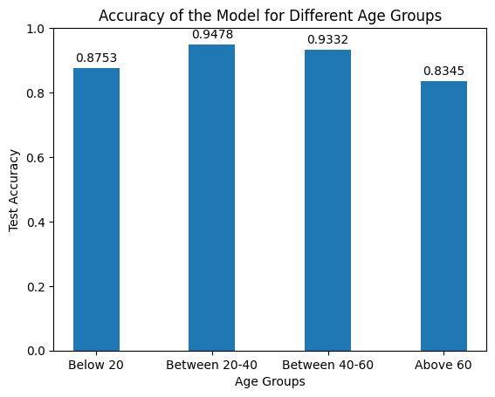
(2) Age Bias Mitigation
(by In-processing technique: Adversarial Training)
Before Adversarial training with Age bias
After Oversampling + Adversarial training
3 % Improvement for older age groups.
Need to tune hyperparamters for better improvements.

Slide 23
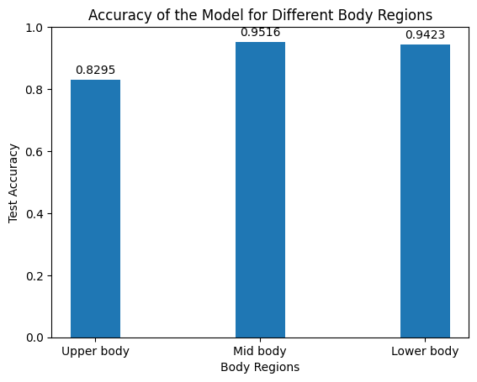
(3) Localization Bias Mitigation
(by Pre-processing technique: Oversampling)
Before Oversampling
After Oversampling minority body region groups
Oversampling has increased Test accuracy for minority class (Upper body) to some extent.

Slide 24
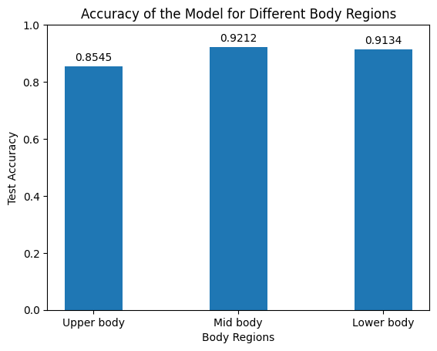
(2) Localization Bias Mitigation
(by In-processing technique: Adversarial Training)
Before Adversarial training with Localization bias
After Oversampling + Adversarial training
7% Improvement for Upper body region.
Decreased performance for other body region groups

Slide 25
Conclusion:
Mitigation techniques such as data augmentation (oversampling) , class balance loss and adversarial training,
were effective in addressing class bias, age bias, and gender bias, leading to improved model performance
across different demographic groups and body regions.
Adversarial training led to a more balanced performance across different body regions in terms of
age and localization biases, but further tuning of the hyperparameters is needed to balance
fairness and accuracy.
.

Slide 26
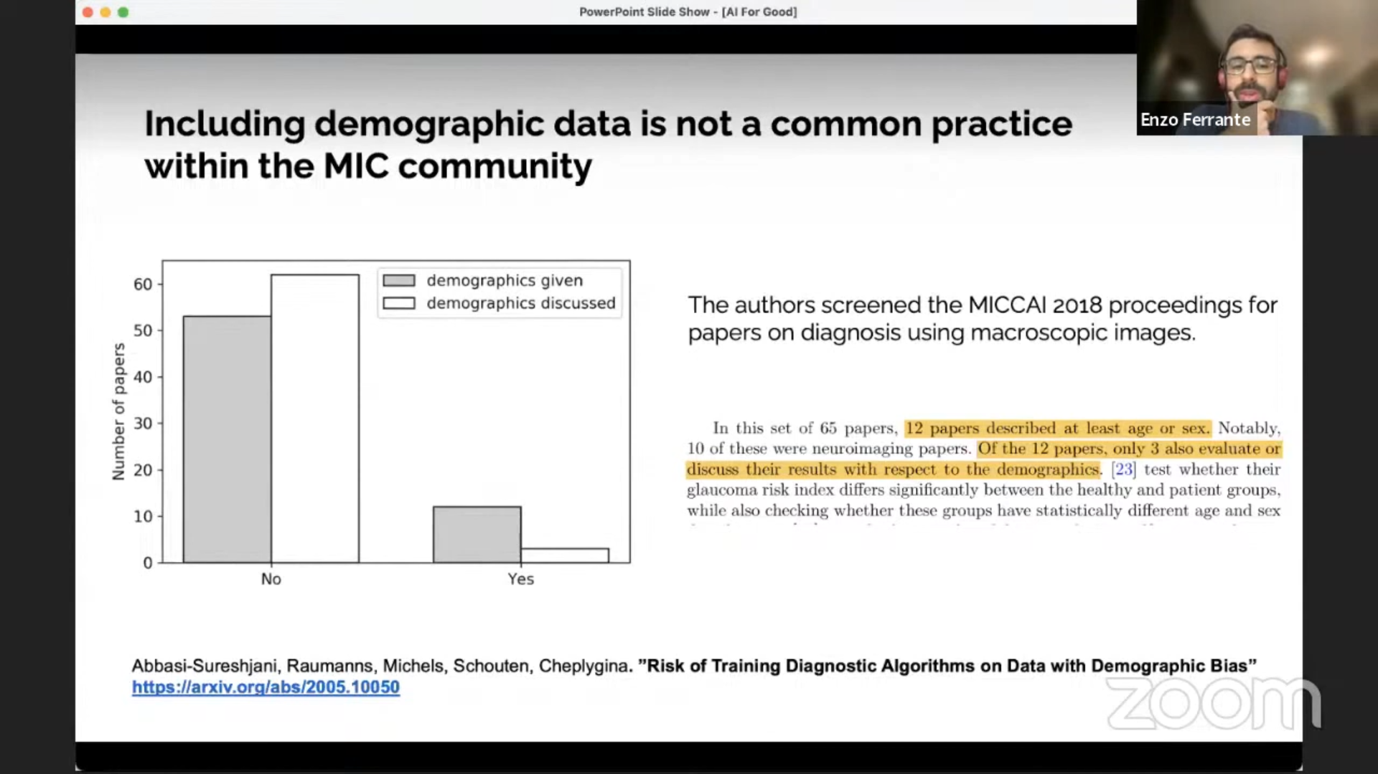
Takeaways:
Authors should report the demographic information together with their published papers and also
the public datasets should be released along with the demographic statistics so that it doesn’t lead to
developing biased models.
Reference: Risk of Training Diagnostic Algorithms on Data with Demographic Bias

Slide 27
Future Work
Refine mitigation techniques for better balance between fairness and accuracy, potentially through novel data augmentation strategies, alternative oversampling methods, fine-tuning adversarial training, or experimenting with new class balance loss functions and other Bias Mitigation techniques.
Investigate the interplay between different biases and their combined impact on model performance, and validate the effectiveness of mitigation techniques on larger and more diverse datasets to ensure generalizability and applicability in real-world clinical settings.

Slide 28
References
[1] A Survey of Fairness in Medical Image Analysis: Concepts, Algorithms, Evaluations, and Challenges
[2] Bias Mitigation for Machine Learning Classifiers: A Comprehensive Survey
[3] Class-Balanced Loss Based on Effective Number of Samples
[4] Risk of Training Diagnostic Algorithms on Data with Demographic Bias

Slide 29
THANK YOU

